Slide 1


DESIGN 1
Lesson 3: Build Sprint 1: Text Content
Ms. Abboud • Grade 9 - Design 1 • Term 1, Week 10

Slide 2
Learning Objectives
WALT - We Are Learning To
WILF - What I'm Looking For
Build the text for my Home page and one more page.
My headings are in a logical order.
At least 2 pages have real content.

Slide 3
Frayer Model: Heading (Review)
DEFINITION
CHARACTERISTICS
A heading tag (h1 to h6) that labels a page or section; h1 is the most important.
h1 to h6; one h1 per page; creates page structure.
HEADING
EXAMPLES
NON-EXAMPLES
<h1>Desert Animals</h1>; <h2>The Arabian Oryx</h2>.
<p>; <strong> (formatting, not a heading).

Slide 4
National Identity Integration
UAE Smart Government: UAE government websites are planned around the people who use them. Today you plan your own website for a specific audience, the same way.

Slide 5
STARTER
Which Tags Organise Text?
List them: h1-h6, p, strong, em, ul, ol, li.
Which one should appear only once on a page?
Hook • Engage & Ask
5 - 10 minutes

Slide 6
LESSON CORE
I Do: Structure Your Words
One h1 for the page, h2 for each section, p for paragraphs, a list where it helps.
Write in your own words: no copying from websites or AI.
Gradual Release of Responsibility
30 - 40 minutes
Example: a well-structured Home page
<h1>Desert Animals of the UAE</h1>
<p>The UAE desert is home to <strong>amazing</strong> animals.</p>
<h2>Animals on this site</h2>
<ul>
<li>Arabian oryx</li>
<li>Falcon</li>
</ul>
1 / 2

Slide 7
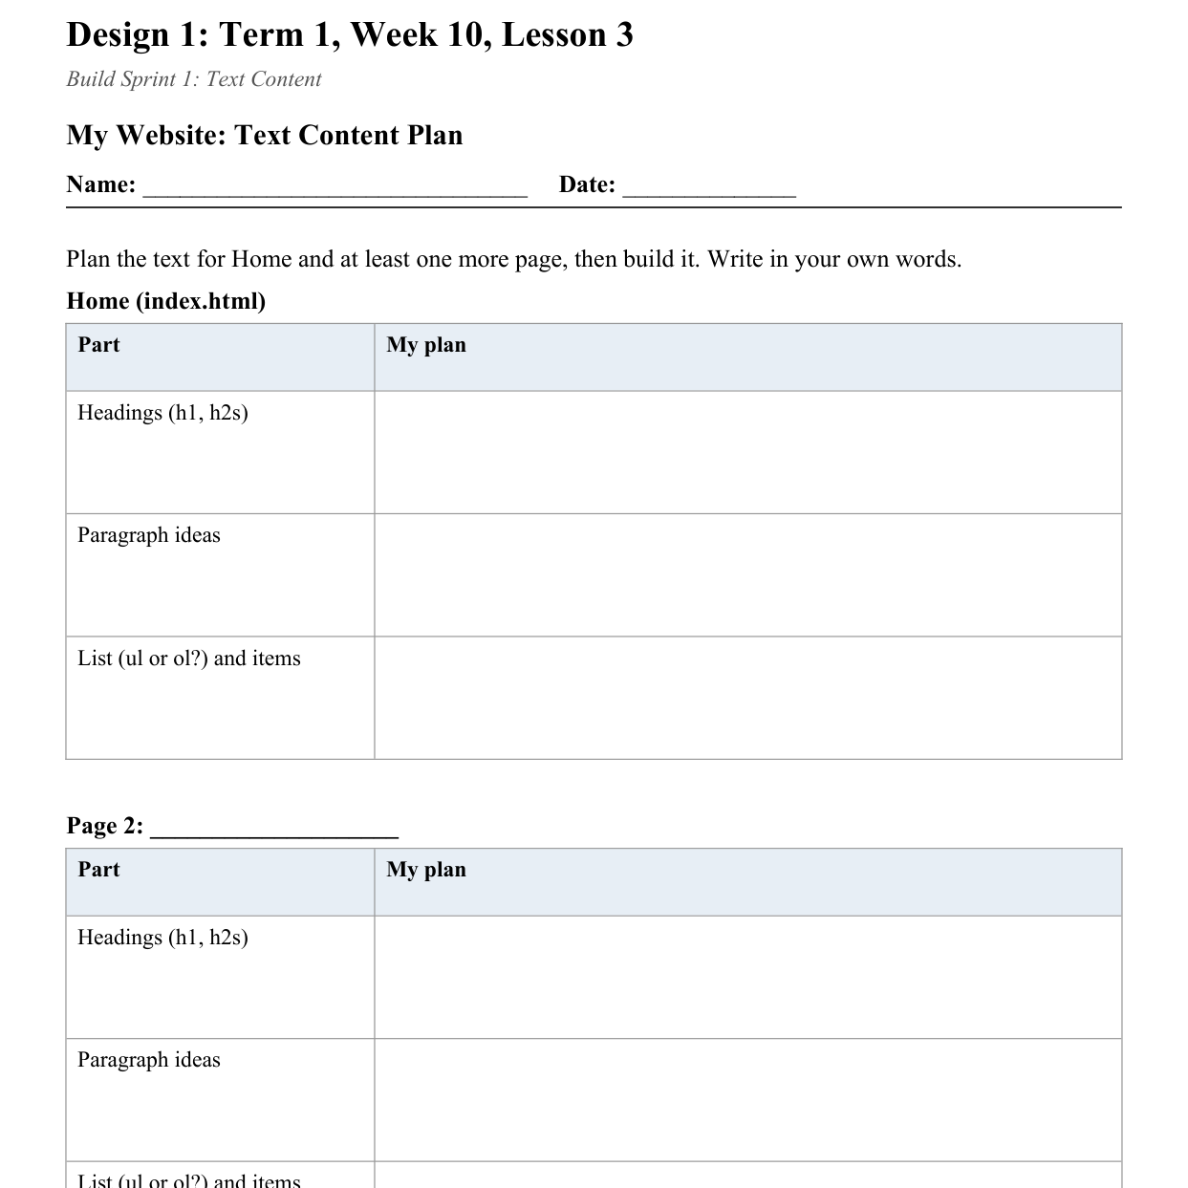
LESSON CORE
You Do: Plan, Then Build
Plan the text for Home and one more page.
Build it, then check the heading order.
Activity: Text Content Plan
Gradual Release of Responsibility
30 - 40 minutes
2 / 2

Slide 8
CLOSURE
Exit Ticket
Which page is next, and what content will it have?
Transition & Extend
5 - 10 minutes

